Slide 1
Spherical Trigonometry (part 2)
MATH 12

Slide 2
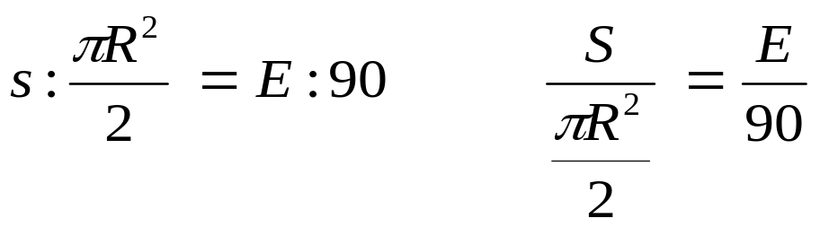
Area of Spherical Triangle
In elementary solid geometry, the area of two spherical triangles lying on the same sphere have the same ratio as their spherical excesses.
The spherical excess E of a spherical triangle is defined by the relation:
E = A + B + C - 180°
A spherical triangle is said to be trirectangular if each of its angles is 90°. So that its E=90° and its area is 1/8 of the area of the sphere where it lies, that is, πR²/2 where R is the radius of the sphere. If S is the area of a spherical triangle of spherical excess E, by ratio and proportion we have:

Slide 3
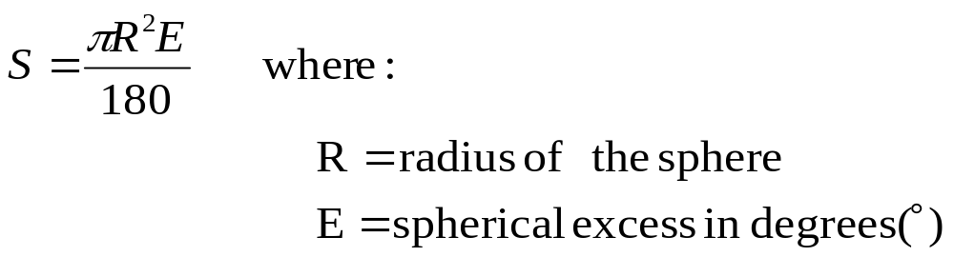
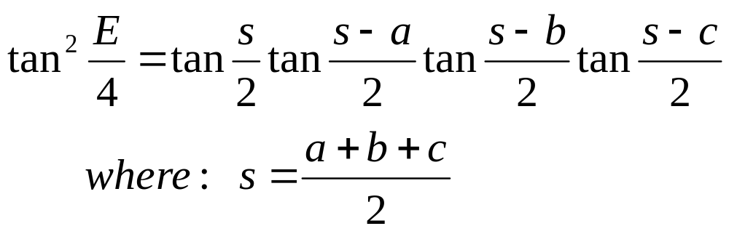
When three angles are given: E=A+B+C-180°
When three sides are given:

Slide 4
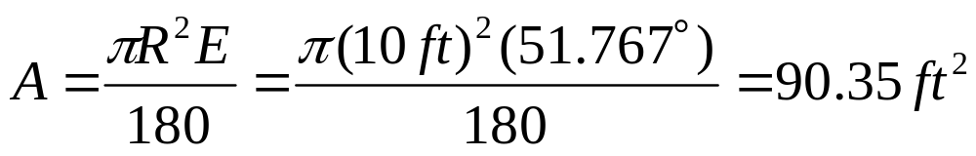
Sample Problem
Given: A=72°31’; B=58°6’ and C=101°9’
Find E.
E=72°31’+58°6’+101°9’-180° =51°46’=51.767°
Find the area of the spherical triangle above if the triangle lies on a sphere of radius 10 ft.

Slide 5
Applications of Spherical Trigonometry
Spherical trigonometry has many applications in navigation, astronomy and geodesy.
The Terrestrial Sphere
Consider the terrestrial sphere, which is the earth of radius 3958.6 miles, the shortest distance between two points upon its surface may be found as well as the bearing of one point from the other. The shortest distance is measured along the shorter arc of the great circle joining the points.

Slide 6
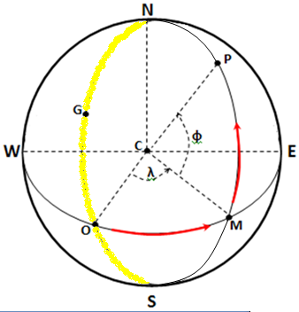
Terrestrial Sphere
principal meridian
The position of P on the earth’s surface is fixed by giving its distances measured along the arcs of two great circles from two reference circles.
The great circles commonly used as reference circles are the equator and the meridian through Greenwich, England.
Meridian- is a great circle passing through the north and the south poles of the earth.
The principal or zero meridian passing through Greenwich, England is marked NGOS and the equator EMOW.
The position of P is fixed if arc OM and MP are given.
The values of these arcs, usually expressed in degrees, minutes and tenth of a minute are called the longitude λ and the latitude Ф, respectively of the point P.
equator
Notes:
The

Slide 7
Terrestrial Sphere
The longitude of P is measured from point O (from the principal meridian, along the equator) to point M on the meridian upon P lies.
The direction in which longitude is measured from point O is indicated by attaching E or W to the number of degrees in the longitude which may range from 0° to 180°.
The latitude of P is measured from point M (from the equator, along the meridian where P lies) to point P.
By attaching N or S to the number of degrees in the latitude, we indicate that the point P lies in the northern or southern hemisphere, respectively.
For example, the longitude and latitude of Boston may be conveniently written as:
Boston (long. 71°5’ W, lat. 42°21’ N)
principal meridian
equator
Notes:
The

Slide 8
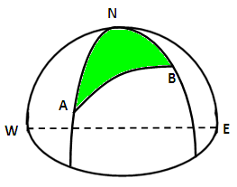
The Terrestrial Triangle
Any two points A and B on the earth’s surface form with the North pole N a spherical triangle called the terrestrial triangle.

Slide 9
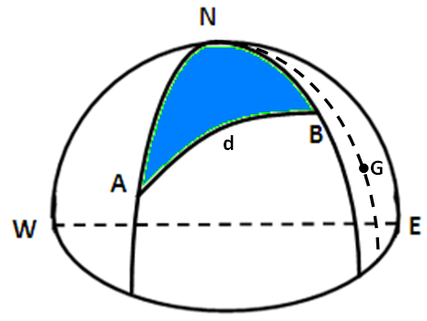
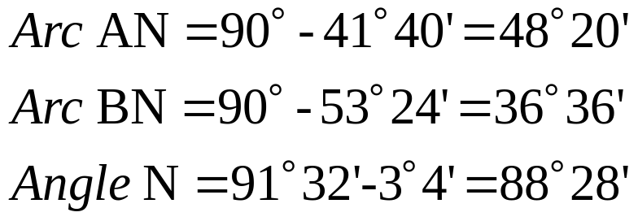
Terrestrial Triangle: Illustrative Example
Find the distance in miles from Iowa City (long.91°32’ W, lat.41°40’N) to Liverpool (long.3°4’ W, lat.53°24’N) and the bearing of Liverpool from Iowa City.
We now have two side and the included angle known, so this is Case IV.
Let A, B, and N denote the positions of Iowa City, Liverpool and the North Pole, respectively.

Slide 10
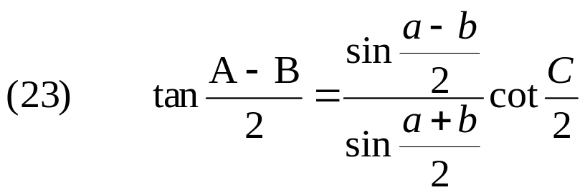
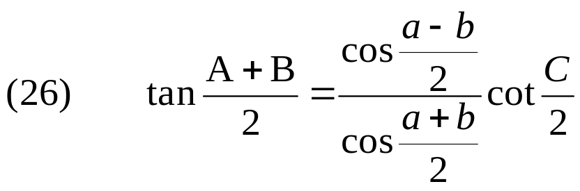
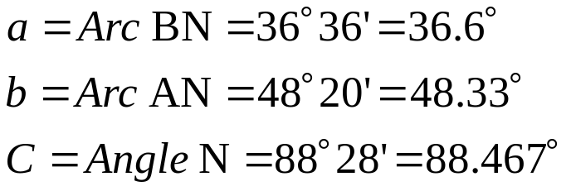
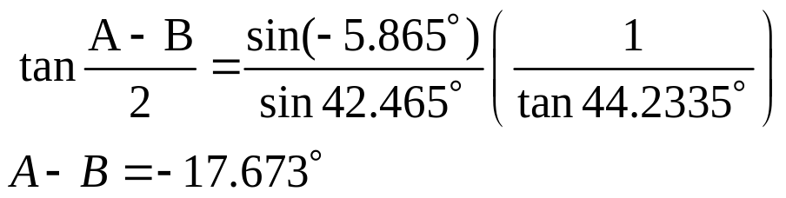
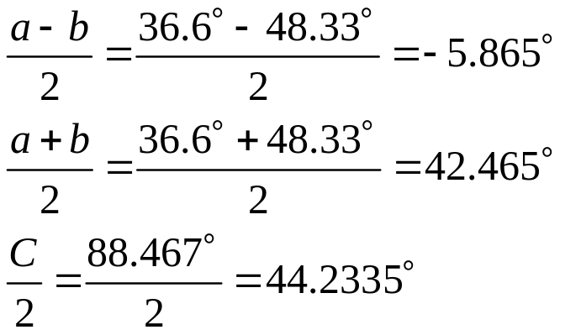
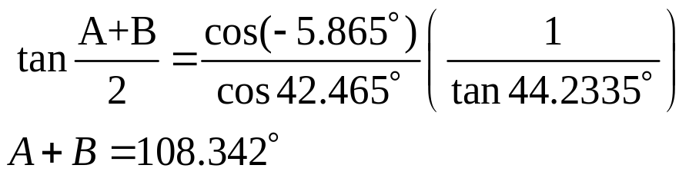
Terrestrial Triangle: Illustrative Example
Using Napier’s Analogies:

Slide 11
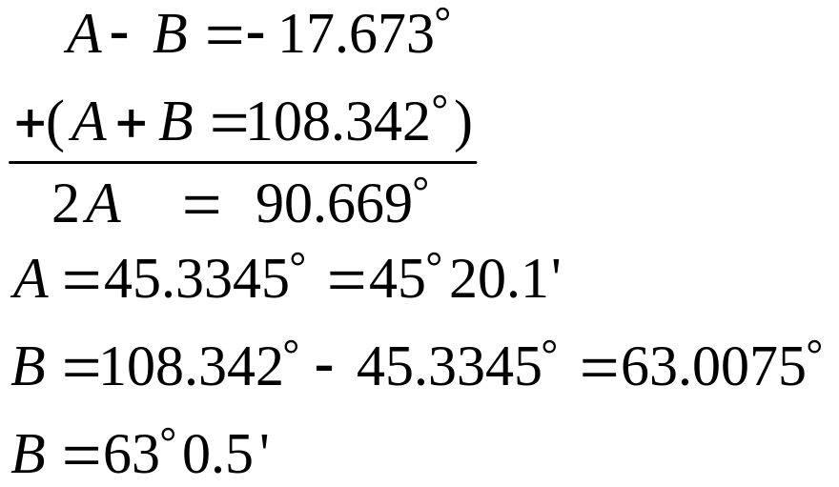
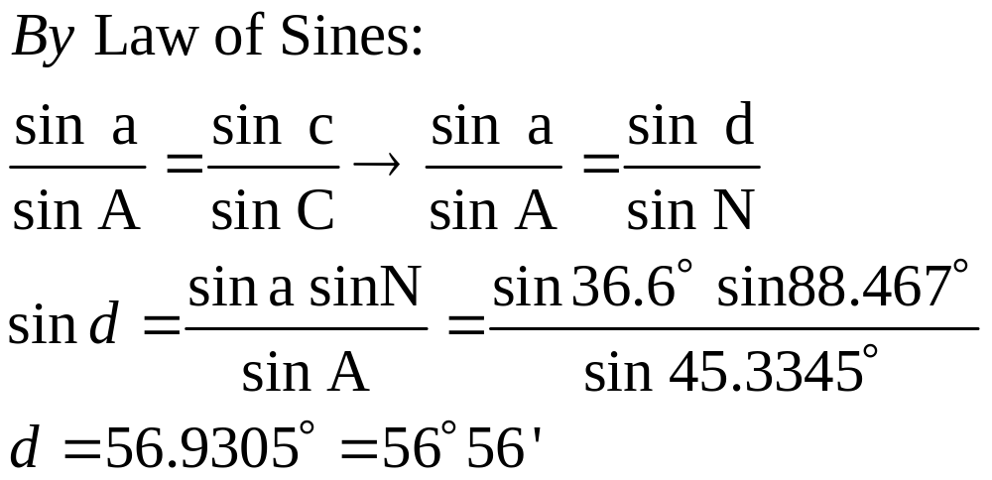
Terrestrial Triangle: Illustrative Example
Solving the two equations simultaneously,
Notes:
Solving

Slide 12
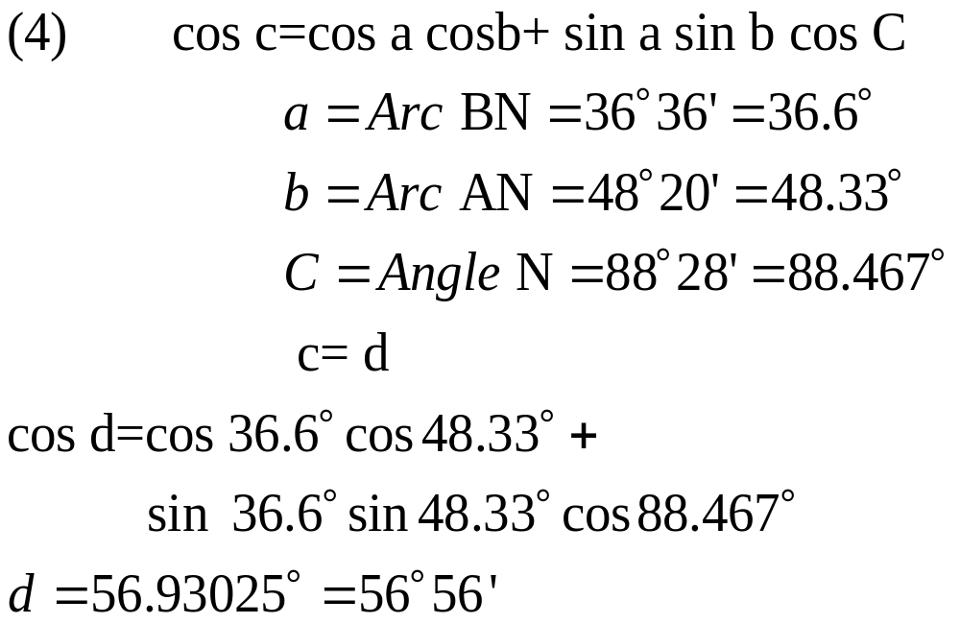
Terrestrial Triangle: Illustrative Example
Alternate Solution: By using Law of Cosines for sides:
Notes:
Solving

Slide 13
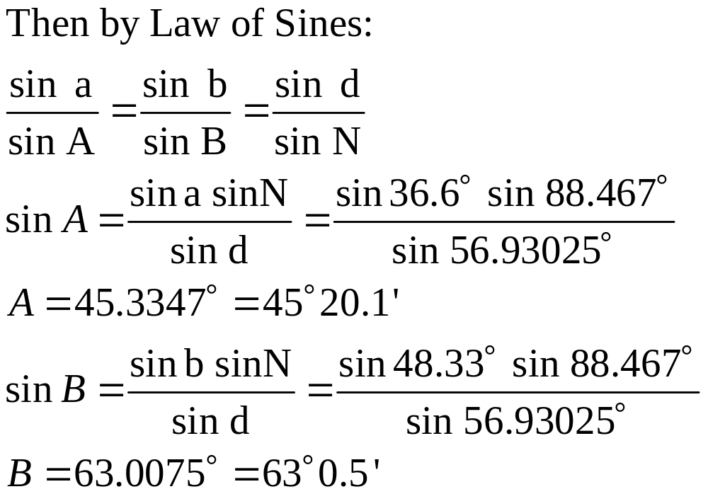
Terrestrial Triangle: Illustrative Example
Notes:
Solving

Slide 14
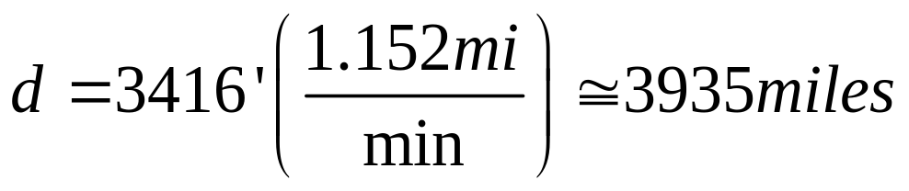
Terrestrial Triangle: Illustrative Example
For d=56°56’=56(60)+56=3416’ and
1’ of arc on a great circle on earth is equal to 6080 ft. or 1.152 miles or one nautical mile.
Since A=45°20.1’, then Liverpool has a bearing of N 45°20.1’ E from Iowa City.
Notes:
Solving

Slide 15
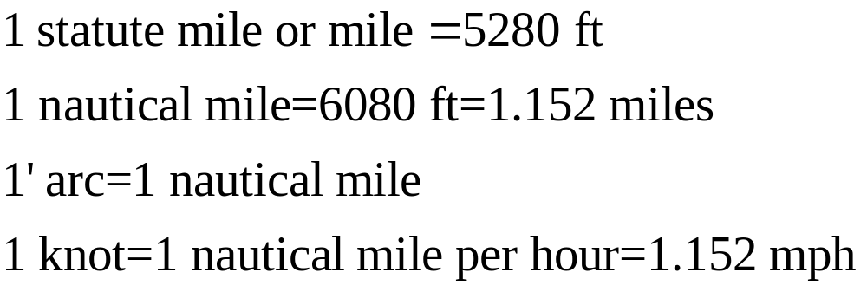
Conversions:
Notes:
Solving

